Slide 1

TEAM 3!
Members: John Doligale V, Tori Faith Jones,
A.J. McClain, Om Nepal, Kritika Upadhyay

Slide 2




We have a Problem!
Gap Between Those Needing Volunteers and Those Wanting to Volunteer

Slide 3


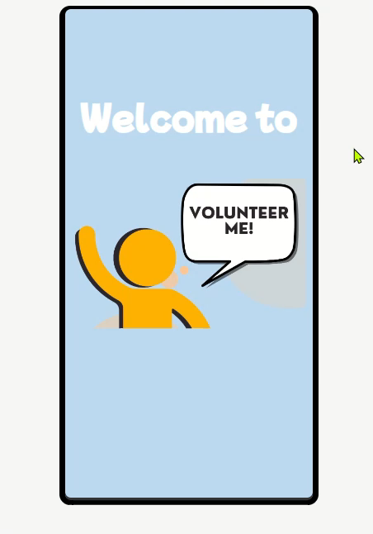


A Mobile Volunteer Application to Bridge the Gap!
We found a Solution!

Slide 4




Volunteers
Our Market
Students
Tenure Employees
Needing Volunteers
2 Sided
Market
Universities
Sorority/ Fraternity
Government Entities

Slide 5







Our Business Model
$
FREE
Volunteers
Orgs
Charities
Sponsors
$
$

Slide 6




Thank you!

